Slide 1

The Most Valuable Eigenvector
Hung-yi Lee
Notes:
Begin
1.
Idea: eigen value =1
2.
Dim of eigen value = 1 is 1 unique (add M)
3.
Power method
end

Slide 2
Reference
THE $25,000,000,000 EIGENVECTOR: THE LINEAR ALGEBRA BEHIND GOOGLE
http://userpages.umbc.edu/~kogan/teaching/m430/GooglePageRank.pdf
A SURVEY OF EIGENVECTOR METHODS FOR WEB INFORMATION RETRIEVAL
http://doradca.oeiizk.waw.pl/survey.pdf

Slide 3
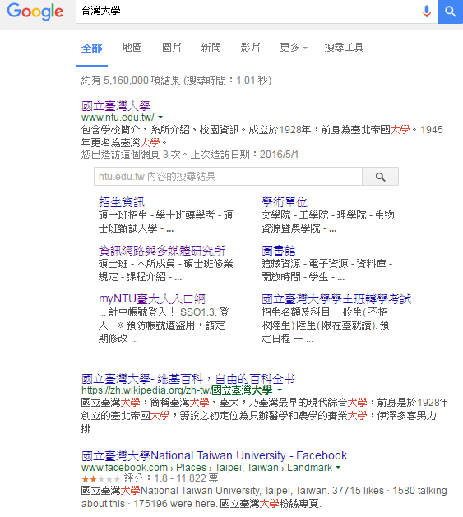

Search
http://incomebully.com/does-pr-pagerank-still-matter/
Notes:
How to rank

Slide 4
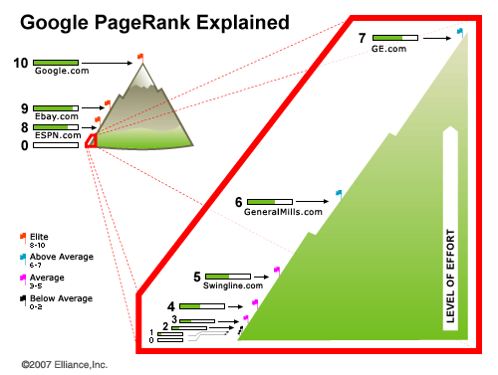
http://www.hobo-web.co.uk/google-pr-update/

Slide 5
PageRank
Rank：8 Google台灣首頁：www.google.com.tw Youtube台灣首頁：http://tw.youtube.com 台灣大學網站首頁：www.ntu.edu.tw
Information of 2008
Rank：7 痞客邦首頁：www.pixnet.net 104人力銀行：www.104.com.tw
無名小站首頁：www.wretch.cc
Rank：6 博客來網站：www.books.com.tw 聯合新聞網首頁：http://udn.com 天下雜誌網站首頁：www.cw.com.tw
Rank：5
推推王網站：http://funp.com 愛情公寓網站：www.i-part.com.tw KKman網站首頁：www.kkman.com.tw
Rank：4 工頭堅部落格：http://worker.bluecircus.net 白木怡言部落格：www.yubou.tw RO仙境傳說網站：http://ro.gameflier.com
Source: http://terrylogin.blogspot.com/2008/09/pagerank.html

Slide 6
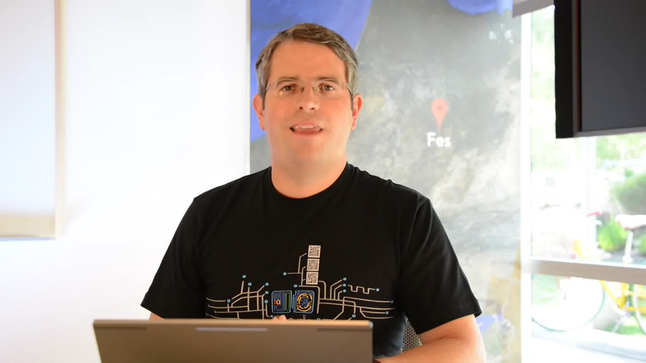
PageRank

Slide 7
Actually ……
The Last Toolbar Pagerank Update was December 2013
Google declared thereafter: “PageRank is something that we haven’t updated for over a year now, and we’re probably not going to be updating it again going forward, at least the Toolbar version.“
Notes:
https://www.gotchseo.com/increase-google-rankings/

Slide 8
PageRank
Webpages with a higher PageRank are more likely to appear at the top of Google search results.
PageRank relies on the uniquely democratic nature of the web by using its vast link structure as an indicator of an individual page’s value.
Google interprets a link from page A to page B as a vote, by page A, for page B.

Slide 9

Importance
很多網頁連到
被重要網頁連到
很多網頁連到
hyperlink

Slide 10
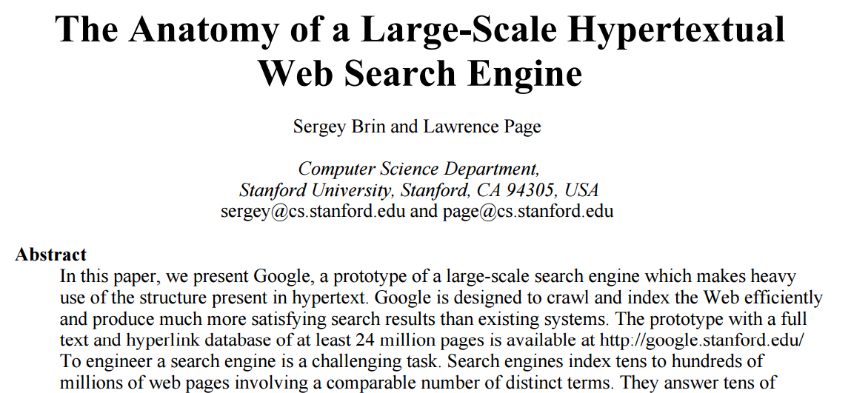
PageRank
Notes:
Autonomy? 自治???

Slide 11

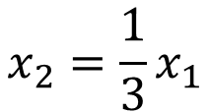
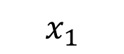
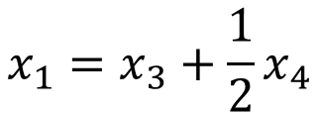
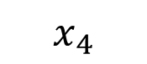
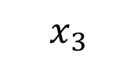
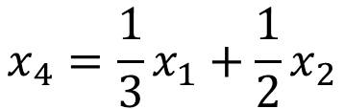
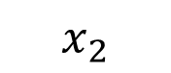
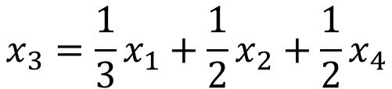
Importance - Formulas
$$x_{1}$$
$$x_{3}$$
$$x_{1}=x_{3}+\frac{1}{2}x_{4}$$
1
3
$$x_{2}=\frac{1}{3}x_{1}$$
$$x_{3}=\frac{1}{3}x_{1}+\frac{1}{2}x_{2}+\frac{1}{2}x_{4}$$
1/2
2
4
$$x_{4}=\frac{1}{3}x_{1}+\frac{1}{2}x_{2}$$
1/2
$$x_{2}$$
$$x_{4}$$
Consider a random surfer
Notes:
Depned on others, but normalization is needed
surfer

Slide 12
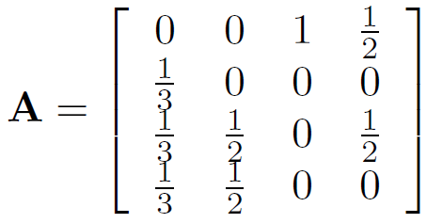

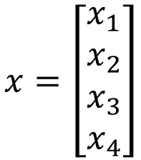
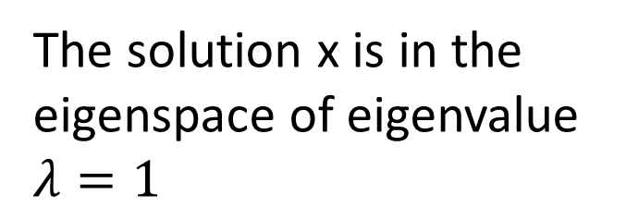
Importance - Formulas
$$x=\left[\begin{aligned}x_{1} \\ x_{2} \\ x_{3} \\ x_{4}\end{aligned}\right]$$
$$x_{1}=x_{3}+\frac{1}{2}x_{4}$$
$$x_{2}=\frac{1}{3}x_{1}$$
$$Ax=x$$
$$x_{3}=\frac{1}{3}x_{1}+\frac{1}{2}x_{2}+\frac{1}{2}x_{4}$$
The solution x is in the eigenspace of eigenvalue $λ=1$
$$x_{4}=\frac{1}{3}x_{1}+\frac{1}{2}x_{2}$$
Notes:
Eigen value = 1

Slide 13
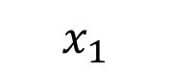
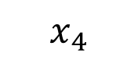
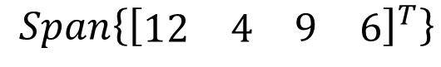
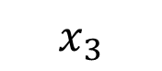
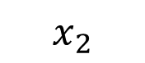
Importance - Formulas
$$x_{1}$$
$$x_{3}$$
12
9
$$x=\left[\begin{aligned}x_{1} \\ x_{2} \\ x_{3} \\ x_{4}\end{aligned}\right]$$
1
3
$$Ax=x$$
The solution x is in the eigenspace of eigenvalue $λ=1$
2
4
$$x_{2}$$
4
6
$$x_{4}$$
$$Span\left\{{\left[\begin{matrix}\begin{matrix}12 & 4\end{matrix} & \begin{matrix}9 & 6\end{matrix}\end{matrix}\right]}^{T}\right\}$$
Notes:
Hack this????????????????????

Slide 14
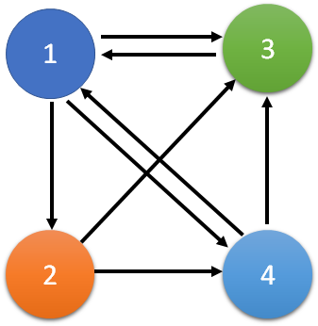


Eigenvalue = 1
$$Ax=x$$
Column-stochastic Matrix
Column-stochastic matrix always have eigenvalue $λ=1$
How about the Dangling nodes (只入不出)?

Slide 15

Unique Ranking?
$$x_{1}$$
$$x_{3}$$
12
9
1
3
Having eigenvalue $λ=1$
If the dimension of the subspace is 1
2
4
Unique Ranking
$$x_{2}$$
4
6
constraint
$$x_{4}$$
Unique Score

Slide 16

Unique Ranking?
How about dimension > 1
Dim for $λ=1$ is 2
Basis:
1/2
1
0
3
0
1
1/2
3
0
5
0
5
1/2
2
0
4
0
2
1/2
4
Any linear combination is in the eigenspace
Not Unique Ranking
Notes:
Example of number
Random surfer

Slide 17

Unique Ranking?
How about dimension > 1
Dim for $λ=1$ is 2
Basis:
1/2
1
0
3
0
1
1/2
3
0
5
0
5
1/2
2
0
4
0
2
1/2
4
Column-stochastic matrix and “positive”
the dim of the eigenvalue $λ=1$ is 1
Notes:
Example of number
Random surfer

Slide 18
Unique Ranking?
Can it be non-uniform?
All entries are 1/n
0.15
Follow the link
random
There are two ways to surf the web
Prob 1 – m:
Prob m:
1
3
1
3
5
5
2
4
2
4

Slide 19
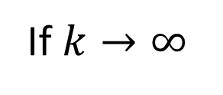




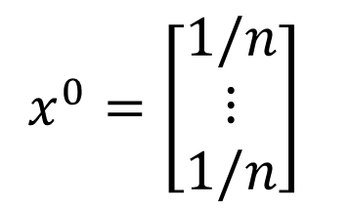
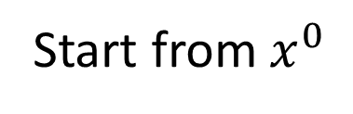
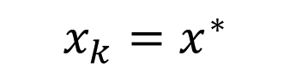
Power method
Start from $x^{0}$
$x^{0}=\left[\begin{matrix}1/n \\ ⋮ \\ 1/n\end{matrix}\right]$
Find $x^{∗}$, such that $x^{∗}=Mx^{∗}$
M is very large
all positive, sum to 1
$$x^{1}=Mx^{0}$$
$$x^{2}=Mx^{1}$$
If $k→∞$
$$x_{k}=x^{∗}$$
……
$$x^{k}=Mx^{k−1}$$
Proof
Notes:
The following example shows that stochastic matrices do not need to be diagonalizable
The picture of a positive stochastic matrix is always the same, whether or not it is diagonalizable: all vectors are “sucked into the 1-eigenspace,” which is a line, without changing the sum of the entries of the vectors. This is the geometric content of the Perron–Frobenius theorem.
【數】冪，次方[C]

